Slide 1
Inland navigation development center
Ivan Šuker, Marko Maruna, Alen Pokos, Hrvoje Kotnik Zagreb, 13.11.2013.

Slide 2
Summary
Brief history and current activities
BulRis
E-Port
Improvement of STI/VTT
Development of new architecture
Questions? We are here all week.

Slide 3
Past years
During the past years we have been working on:
Implementation of River Information Services in Bulgaria – BulRis
Completion of Sava Navigo and execution of follow-up project Discover Posavina
Successful participation in Platina, Hint, Neli, Rising
Involvement in development of strategies and legal aspects of Inland navigation in Croatia

Slide 4
Summary
Focus in last years of development was on improvement existing technologies, adopting new standards and creating new possibilities.
Improvement in VTT –with using new technoligies creating more efficient, more adoptable and cheaper solution.
ePort – Introducing RIS into Port related processes.
New system arhitecture
Working on domestic and international projects

Slide 5
Projects highlights
Platina II
Involved to provide quality IT services to the project
Responsible for operation and enhancement of RIS community portal
International RIS Data exchange
Software up-to-date with the latest standard version
Positive results from the testing with already operational partners

Slide 6

BULRIS
Implementation of River Information System in Bulgarian stretch of the river Danube
Marko Maruna Zagreb, 13.11.2013.
Notes:
Continuing with my presentations, I’ll tell you some general facts about BULRIS, problems we came across and importance of this project for our company

Slide 7
About
Project started on May 2010
Estimated end date on November 2011
Funds: 5,6 M€ (co-funded by ERDF)
Contracting Authority: Bulgarian Ports Infrastructure Co.
Halted by the end of 2011 due to infrastructure issues
Notes:
Project was started on May 2010 and should be done until end of 2011. Budget was somewhere about 5,6 M€ and it was 85% co-funded by European Regional Development Fund. Contracting authority is Bulgarian Ports Infrastructure

Slide 8
About - Infrastructure
AIS infrastructure – Base stations + AIS Network
Inland ECDIS – STI/VTT
Data Gateway
NTS Notice to Skippers
Electronic Reporting International ERI
Voice VHF Communication system
Notes:
Project demanded standard RIS tehnologies as well as VHF Communication system

Slide 9
About - Infrastructure
Regional data center in Ruse
8 site locations in Silistra, Tutrakan, Ruse, Svishtov, Somovit, Oriahovo, Lom, Florentin
Notes:
To cover Bulgarian part of Danude it requested 8 base station locations with one regional data center in Ruse

Slide 10
About - Unexpected circumstances
Due too some unexpected circumstances with infrastructure, project was frozen by end of 2011.
Delayed for almost 1,5 year
Unfrozen in first half of 2013, continued 09/2013.
By 10/2013 project is in its final stage.
Training of users and final acceptance to be done by 12/2013
Notes:
What is special about this project? Due too some facts it was stopped for almost one and a half year, and activated by this year. That was the period very important for us to prove ourselfs in front of the project authorities.

Slide 11
Highlights of the project
Change of almost entire project core team
Building the new RIS expert team from scratch
New CRUP team took over and resulted with succesfull execution
Notes:
Despite of changing entire project team and training new people to cover all the tasks needed, we still managed to succesfully bring the project to the end on mutual pleasure of both sides.

Slide 12
Questions?
Marko Maruna
E-mail: maruna@crup.hr
GSM: +385 91 41 81 699
IT department
Notes:
Any questions?

Slide 13
E-port
Electronic port management system
Marko Maruna Zagreb, 13.11.2013.
Notes:
Hello everyone, my name is Marko Maruna from CRUP, from Croatia, and today I’ll interduce you to our application for managing and administrating vessels, transports and related data in harbor. It’’s called E-port and in general, we can say that this is a sort of electronic port management system.

Slide 14
What is E-port?
Application is designed for control and management of the processes in harbor, related to arrival, stay and departure of the vessels.
Application simplifies administrative tasks, and many other tasks, through streamlined processes.
It is single point of information registration and management.
Provides easy and quick access to relevant information for any party of interest
Speed up the processes
Notes:
First of all, what is E-port? What can we use it for? It’s main functionality is to control and manage transports, vessels, cargo and passangers arriving at the port, as well as transported goods and produced costs. Application follows normal port activities and flows, so adjustment to electronic managing should not be a problem.

Slide 15
Who are primary users?
Port authorities
Harbor masters
Border police
Customs
Any other authority that might have interest.
Notes:
Primary users are port authorities, harbor masters, border police, customs and any other

Slide 16
Key features
Management of harbor's transports and vessel tracking, both cargo and passanger
Invoicing – automated process for port dues
Detailed statistics
Interconnection with RIS via AIS and/or ERI
Vessel monitoring in harbor and dislocated area
Notes:
As i told before main key feature is managing transports and vessels, but there are also few more very important features like invoice management for accounting or sending invoices to the vessel operator and so on...
Detailed statistics which covers almost every need of harbor operator or an end user
Connection to Electronic reporting in a purpose of announcing incoming vessels and many more
Monitoring vessel in harbor area so the operater can make preliminary actions as soon as he sees arrived vessel

Slide 17
Key features
Management of all relevant data (vessels, cargo, passengers, companies, costs, prices...), as well as import and export of relevant data
Multiuser and multilevel system architecture (admin, agent, operator, revision...)
Multilanguage support
Notes:
Detailed data classification with importing or exporting feature
Multiuser and multilevel support
Support for any language needed

Slide 18
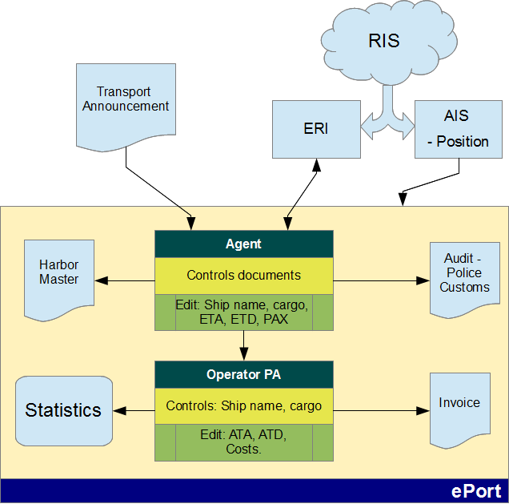
Process
Notes:
On this diagram we can see simplified process for E-port to handle. Agent handles preliminary actions, while operator does final actions. We can also see third parties like harbor masters, or police using E-port data.

Slide 19
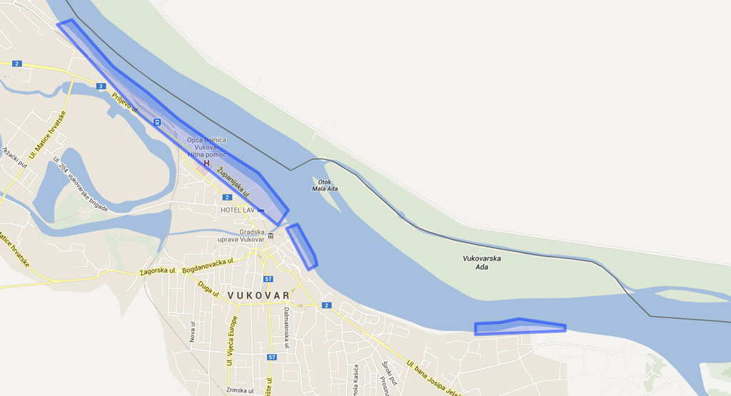
Harbor area - Vukovar
System monitors vessels in defined area
Notes:
Every harbor has defined area, and every vessel caught in this area (by catching vessel’s position over AIS messages) is reported and offered as an announced transport.

Slide 20
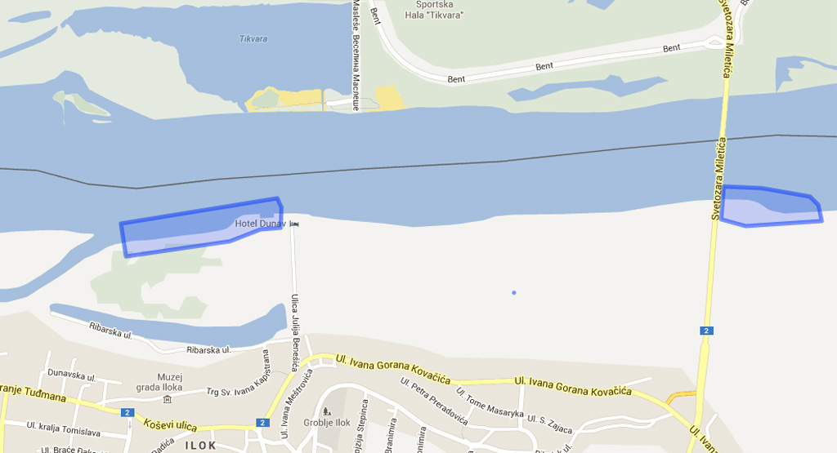
Dislocated area - Ilok
System monitors vessels even in dislocated area
Notes:
This can be done for unlimited number of areas or locations

Slide 21
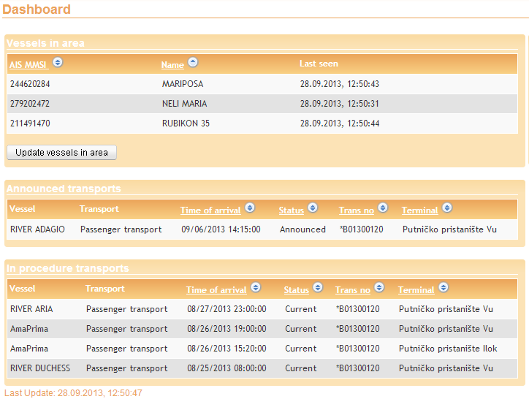
Real status in the harbor is available at any time
Notes:
This is dashboard, main and central application spot with most of important information like vessels in ares, announced transports, transports in procedure and so on...

Slide 22
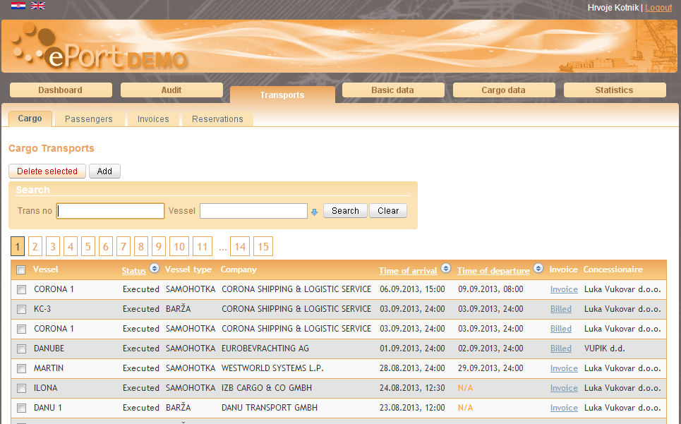
Notes:
And for the end one more view, showing cargo transports with some relevant data for transport and vessel like vessel name, vessel’s operator, time of arrival, time of departure...

Slide 23
Questions?
Marko Maruna
E-mail: maruna@crup.hr
GSM: +385 91 41 81 699
IT department
Notes:
Any questions?

Slide 24
Web STI
New development of web VTT STI application
Alen Pokos Zagreb, 13.11.2013.

Slide 25
Improvement of Web VTT STI
VTT/ STI development
In the past, users have been limited to use of Google Earth to view STI, that has been run as a separate application.
This was, instead of being a feature, one excess usage requirement.

Slide 26
Improvement of Web VTT STI
The goal is to create optimized, more efficient, more adoptable and cheaper solution.
The solution does not depend on 3rd parties.
It is not dependent on particular technology.
In the first stage of improvement, all existing features were moved inside the VTT application.
With this transitional phase, foundation for complete web map based system was set.

Slide 27
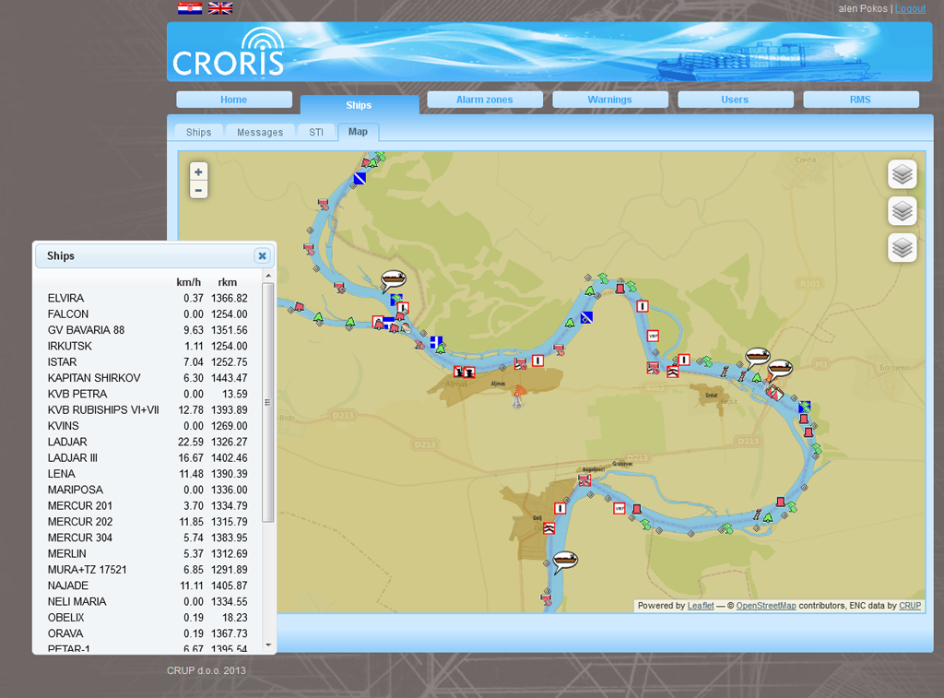
Improvement of Web VTT STI
First stage resulted in positively accepted web map view
Continuing on that, next stage of improvement is set in motion

Slide 28
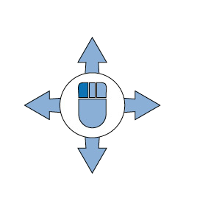
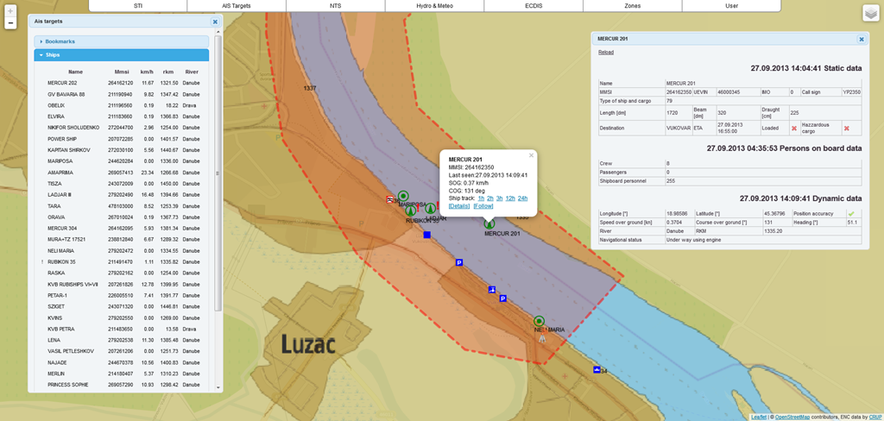
Improvement of Web VTT STI
Giving the user more tools in one place
All of the information and visualization inside users web browser, in full screen

Slide 29
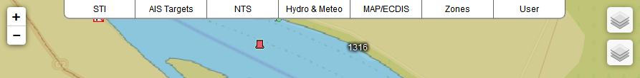
Improvement of Web VTT STI
Make most of screen area. Simplify interface usage and elements
Give the user choice of the data and layout he wants to see
Keep it intuitive

Slide 30
Improvement of Web VTT STI
Real-time fed information
AIS live data and history simulation
One click away information
Target search and details from AIS, ERI, DGW
NTS (search, display, detail)
Hydrological and meteorological data (current, forecasts)
ENC and GIS objects information
Messaging, Alarms, Warnings, Emergencies, RMS
User notes and remarks

Slide 31
Improvement of Web VTT STI
With all of the possible data to be shown, being mindful of screen clutter to provide pleasant UI

Slide 32
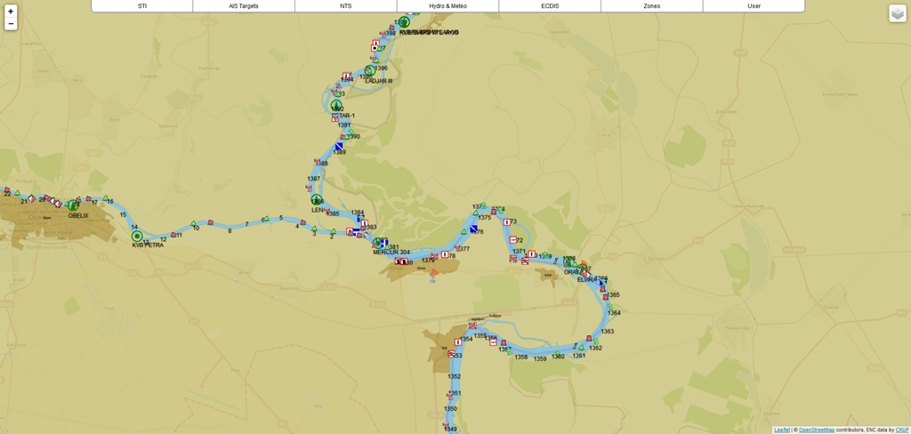
Improvement of Web VTT STI
Display of data, from plentiful …

Slide 33
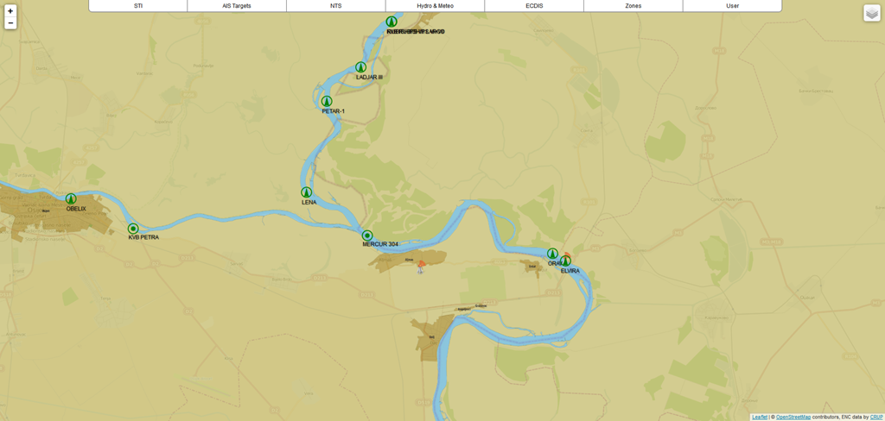
Improvement of Web VTT STI
...to focused.

Slide 34
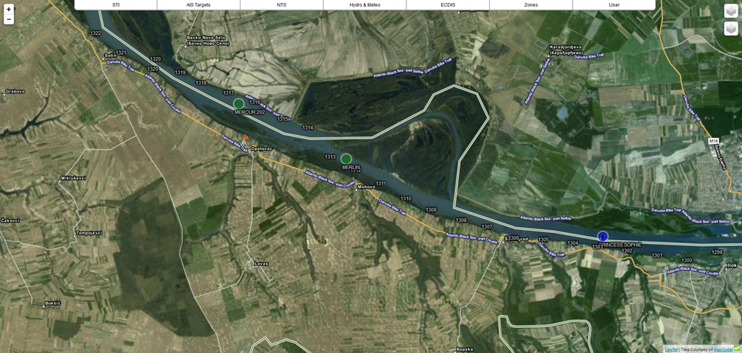
Improvement of Web VTT STI
With different base and added layers

Slide 35
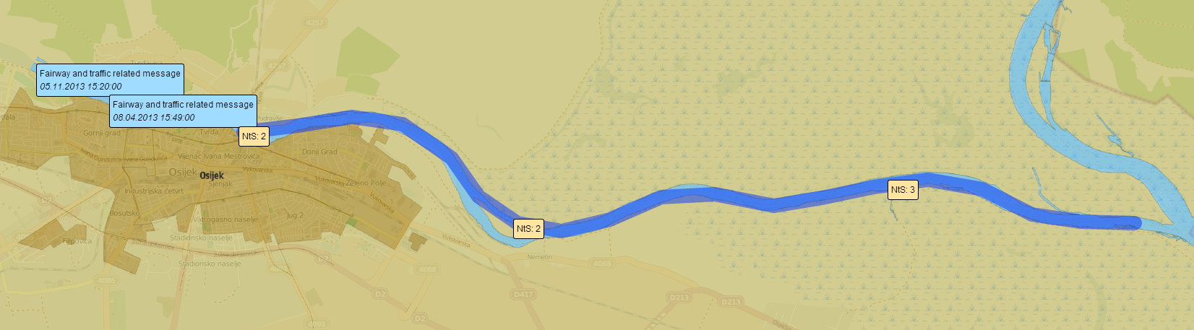
Improvement of Web VTT STI
NTS in text or icon display
Grouping of close by messages
Display of message coverage

Slide 36
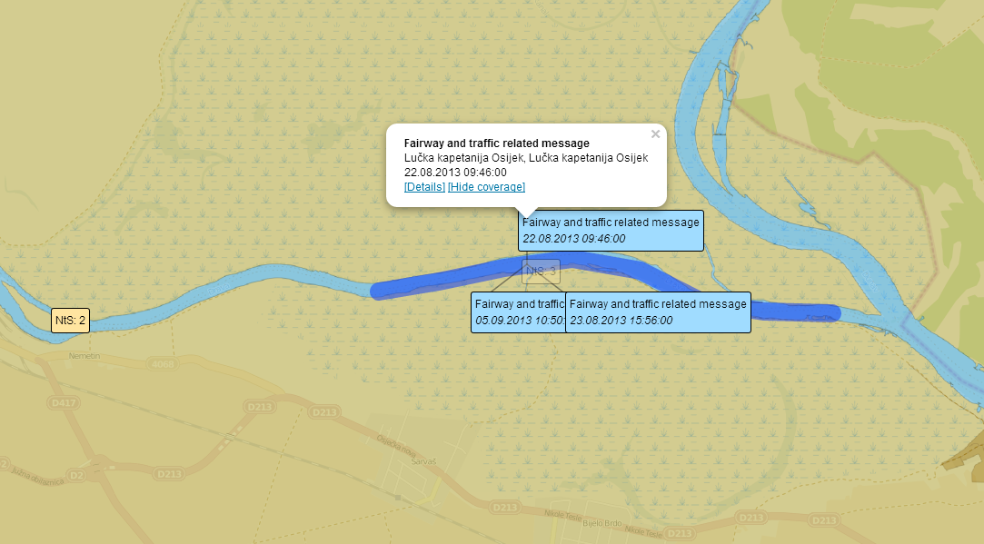
Improvement of Web VTT STI

Slide 37
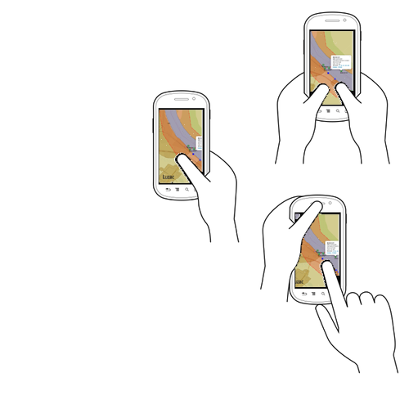
Improvement of Web VTT STI
Above 80% of existing functionalities already available on the tablet devices
Continuously build and improve
Listen for feedback and be in pace with developing standards
Look to incorporate new technologies

Slide 38
Questions?

Slide 39
RIS Architecture
Development of new RIS architecture
Hrvoje Kotnik Zagreb, 13.11.2013.
Notes:
Continuing with my presentations, I’ll tell you some general facts about BULRIS, problems we came across and importance of this project for our company

Slide 40
New system architecture
Motivation for the new architecture
When developing and analyzing the system common points and patterns were identified
The idea of supporting the data for core and external applications in similar way
With the increased interest into expanding the use of RIS and RIS data, aggregation of the same would provide stable foundation

Slide 41
New system architecture
Goals
Single point data source for RIS and RIS data source for variety of other services
With single-sign-on we achieve focused point of control and monitoring of data access and usage
With good technical solutions faster, more stable and more scalable system
Basis for realization of single-window

Slide 42
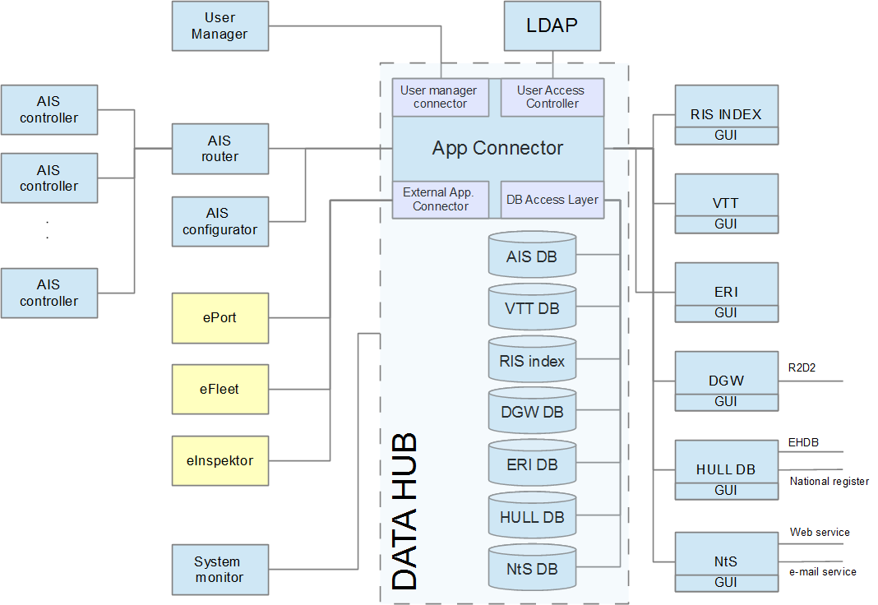
New system arhitecture

Slide 43
Questions?

Slide 44
CRUP d.o.o.
Nova cesta 180
HR-10000 Zagreb
Tel +385 1 631 44 45
Fax +385 1 631 44 44
www.crup.hr
info@crup.hr
Thank you.

